Slide 1
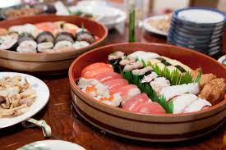
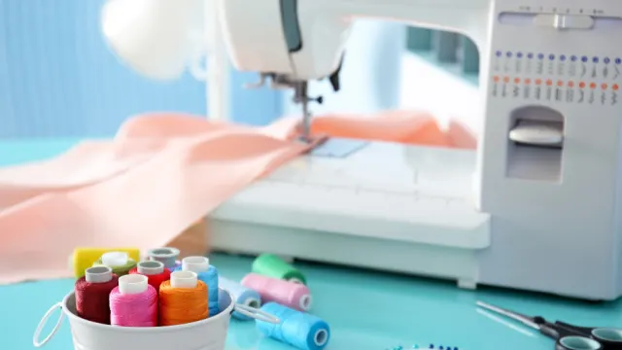
Glenroy Campus Subject Study Hubs

Slide 2
Languages Study Hubs
Japanese Club | Italian Club | French Club
Tuesday Day 7 Lunchtime with Mrs Irihama | Tuesday Day 7 Lunchtime with Mrs Mancuso | Monday Lunchtimes with Ms Nahas
CAM118 | MAG102 | CAM118

Slide 3
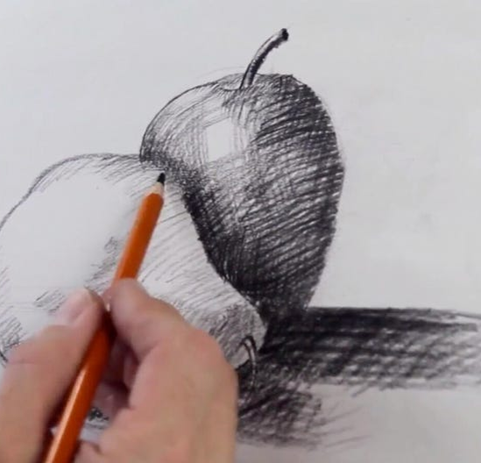
Art Study Hub
The Art Study Hub will be held Thursday Lunchtimes in room AIK001.
The teachers present will be Mr Boland and Mrs Zaf.

Slide 4
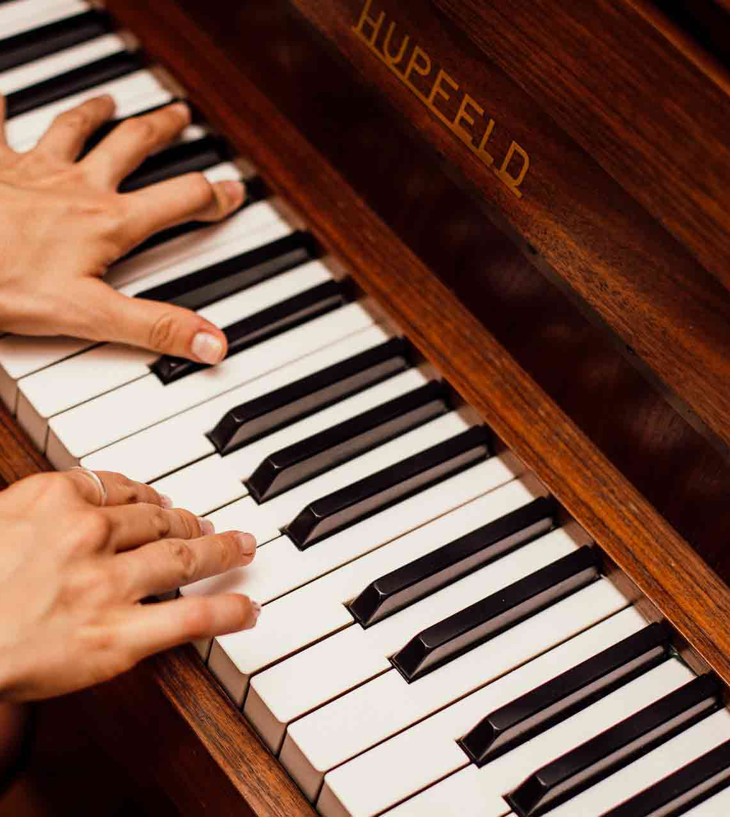
Performing Arts Study Hub
The Performing Arts Study Hub will be held Wednesday Lunchtimes in room CAM109/110.
The teacher present will be Mrs Hatherell.

Slide 5
English Study Hub
The English Study Hub will be held Monday Lunchtimes in room CAM118.
The teacher present will be Mr Ahmar.

Slide 6
Science Study Hub
The Science Study Hub will be held Wednesday Lunchtimes in room CAM118.
The teacher present will be Ms Trapani.

Slide 7
Maths Study Hub
See the Timetable below for more information about Maths Study Hubs!

Slide 8
Homework Club
Homework Club will be held every Wednesday from 3:10-4:10 in room CAM012.
Mr O’Dowd will be supervising.

Slide 9
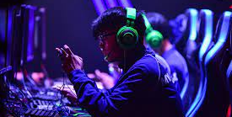
Esports (Rocket League) Club
The Esports Club will be held Friday Lunchtimes in room CAM003.
The teachers present will be Ms Trapani and Mr Bird.

Slide 10
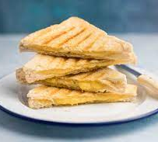
Breakfast Club
Breakfast Club will be every Friday Before School (7:30-8:10) at the Canteen. The teacher present will be Mrs Baker.

Slide 11
Student Services Catch Up Club
The Student Services Catch Up Club will be held on (TBC) at Lunchtime in room CAM016.
The teacher involved will be Mr Katsahambas.

Slide 12
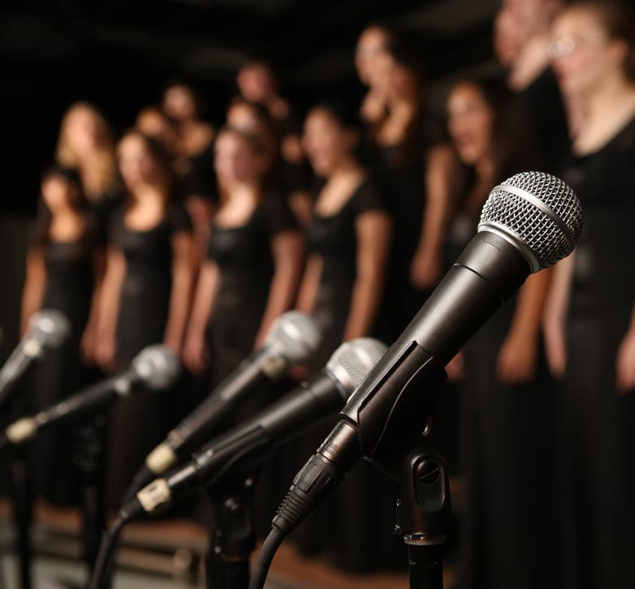
Junior Voices
Junior Voices will be held Friday Lunchtimes in room CAM109.
Mrs Hatherall will run this group.

Slide 13
Junior Concert Band
Junior Concert Band will be held Tuesday Lunchtimes in room CAM115.
Mrs Hatherell will run this group.

